Slide 1

TASK 2
EMPLOYEE DATA ANALYSIS
PREPARED BY Rakhi Ghulaxe

Slide 2
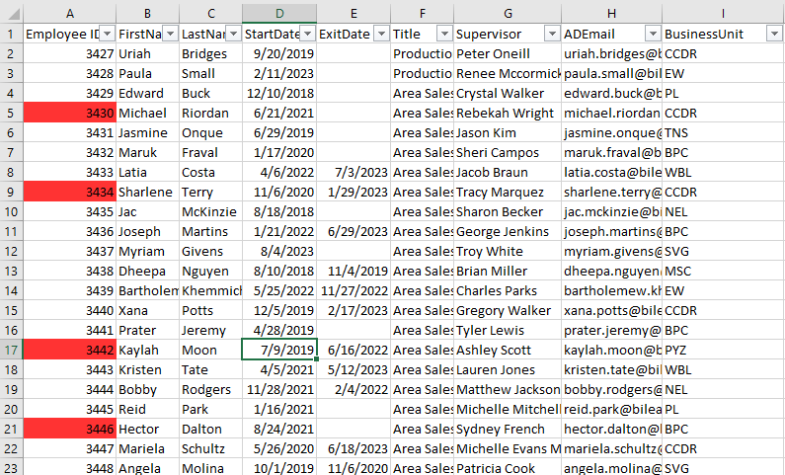
1. Can you create a pivot table to summarize the total number of employees in each department?
Department | Count of Employees
Admin Offices | 80
Executive Office | 24
IT/IS | 430
Production | 2020
Sales | 331
Software Engineering | 115
(blank)
Grand Total | 3000
2. Apply conditional formatting to highlight employees with a "Performance Score" below 3 in red.

Slide 3
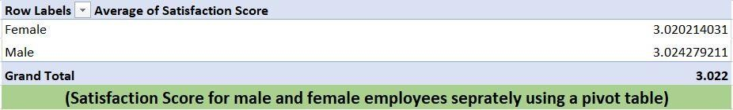
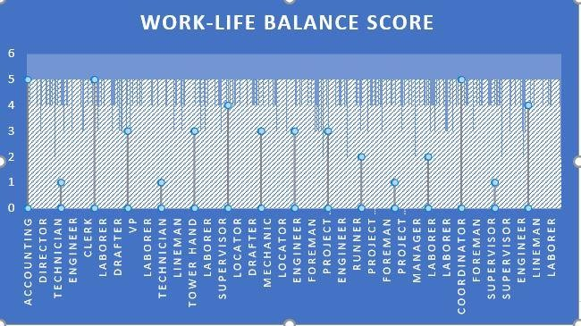
3. Calculate the average "Satisfaction Score" for male and female employees separately using a pivot table.
4. Create a chart to visualize the distribution of "Work-Life Balance Score" for different job functions.

Slide 4
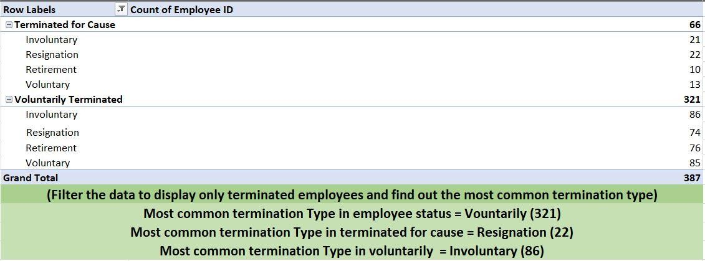
5. Filter the data to display only terminated employees and find out the most common "Termination Type."
6. Calculate the average "Engagement Score" for each department using a pivot table.
Department | Average of Engagement_Score
Admin Offices | 2.93
Executive Office | 3.38
IT/IS | 3.03
Production | 2.91
Sales | 2.99
Software Engineering | 2.97
(blank)
Grand Total | 2.94

Slide 5

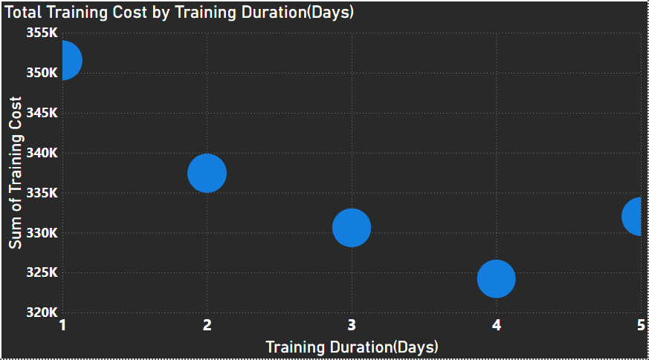
7. Use VLOOKUP to find the supervisor's email address for a specific employee.
8. Can you identify the department with the highest average "Employee Rating?"
Department | Average of Current Employee Rating
Admin Offices | 3.03
Executive Office | 2.79
IT/IS | 2.97
Production | 2.98
Sales | 2.91
Software Engineering | 2.90
(blank)
Grand Total | 2.97
‘Admin Offices’ has the Highest average employee Rating.
9. Create a scatter plot to explore the relationship between "Training Duration (Days)" and "Training Cost."

Slide 6

10. Build a pivot table that shows the count of employees by "RaceDesc" and "GenderCode."
Count of Employee_ID Race | Gender Female |  | Male | (blank) | Grand Total
Asian | 346 |  | 283 | 629
Black | 346 |  | 272 | 618
Hispanic | 325 |  | 247 | 572
Other | 318 |  | 264 | 582
White | 347 |  | 252 | 599
(blank)
Grand Total | 1682 |  | 1318 | 3000
11. Use INDEX and MATCH functions to find the "Training Program Name" for an employee with a specific ID.
Employee | Training Date | Training Program Na | Training Type
1001 | 9/21/2022 | Customer Service | Internal
1002 | 7/19/2023 | Leadership Developm | Internal
1003 | 2/24/2023 | Technical Skills | Internal
1004 | 1/12/2023 | Customer Service | Internal
1005 | 5/12/2023 | Communication Skills | External
1006 | 5/8/2023 | Project Management | Internal
1007 | 5/14/2023 | Leadership Developm | External
1008 | 8/2/2023 | Technical Skills | External
1009 | 8/21/2022 | Customer Service | Internal
1010 | 8/19/2022 | Communication Skills | External
1011 | 11/6/2022 | Communication Skills | Internal
1012 | 3/28/2023 | Technical Skills | External
1013 | 4/8/2023 | Project Management | External

Slide 7
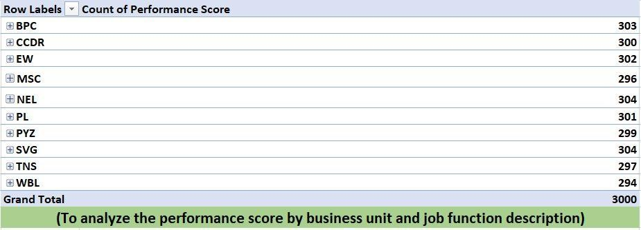
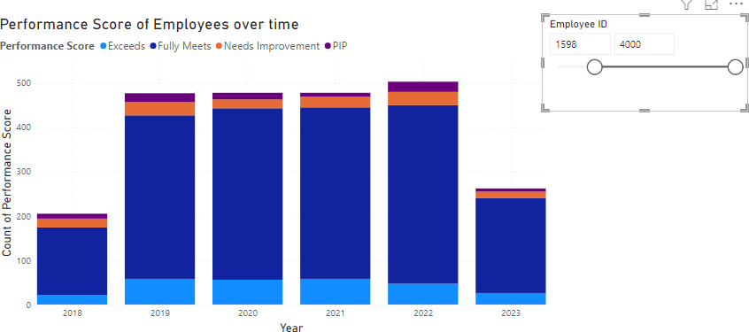
12. Create a multi-level pivot table to analyze the "Performance Score" by "BusinessUnit" and "JobFunctionDescription."
13. Design a dynamic chart that allows users to select and visualize the performance of any employee over time.

Slide 8
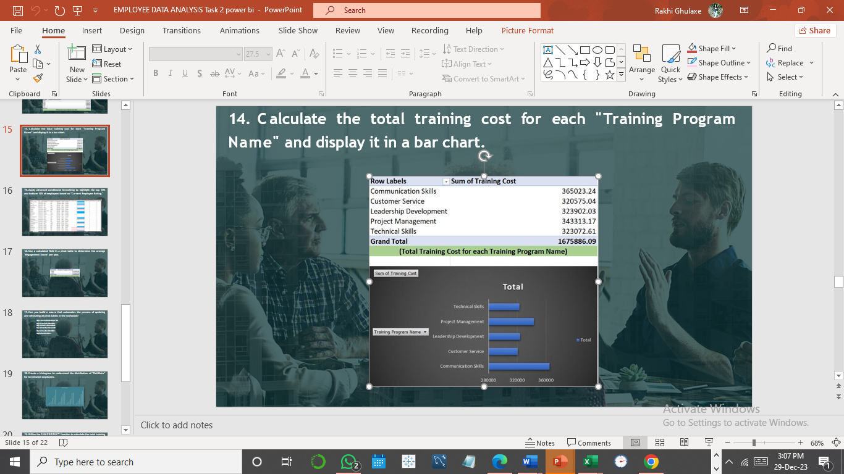
14. Calculate the total training cost for each "Training Program Name" and display it in a bar chart.
15. Apply advanced conditional formatting to highlight the top 10% and bottom 10% of employees based on "Current Employee Rating."
MaritalDe | Performance_Score | Current_Employee_Rating
Single | 3 | 2
Single | 3 | 5
Single | 3 | 4
Single | 3 | 4
Single | 3 | 2
Single | 3 | 4
Single | 3 | 4
Single | 3 | 5
Single | 3 | 1
Single | 3 | 4
Single | 3 | 2
Single | 3 | 5
Single | 3 | 2
Single | 3 | 2
Single | 3 | 1
Single | 3 | 2
Single | 3 | 1
Single | 2 | 2
Single | 3 | 2
Single | 3 | 3
Single | 1 | 4

Slide 9
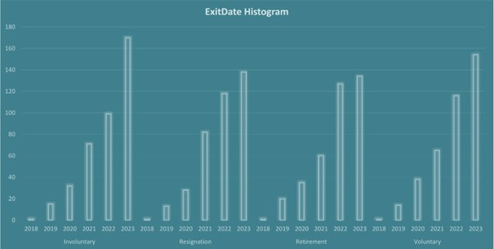
16. Use a calculated field in a pivot table to determine the average "Engagement Score" per year.
Year | Average of Engagement_Score
<8/7/2018
2018 | 2.90
2019 | 3.07
2020 | 2.94
2021 | 2.89
2022 | 2.94
2023 | 2.83
Grand Total | 2.94
17.Create a histogram to understand the distribution of "ExitDate" for terminated employees.

Slide 10
19. Utilize the SUMPRODUCT function to calculate the total training cost for employees in a specific location.
Row Labels | Sum of Training Cost
Aaronborough | 841.22
Aaronburgh | 633.96
Aaronstad | 939.02
Abbottton | 609.01
Acevedoshire | 443.55
Adamborough | 444.22
Adammouth | 1248.77
Adamsberg | 962.45
Adamsmouth | 367.34
Aguirreland | 881.71
Alexanderberg | 494.29
Alexanderchester | 346.93
Alexandraview | 450.64
Alexandriachester | 778.25
Alexishaven | 127.93
Alfredmouth | 328.74
Aliciaburgh | 966.19
Aliciahaven | 373.87
Allenborough | 115.06

Slide 11
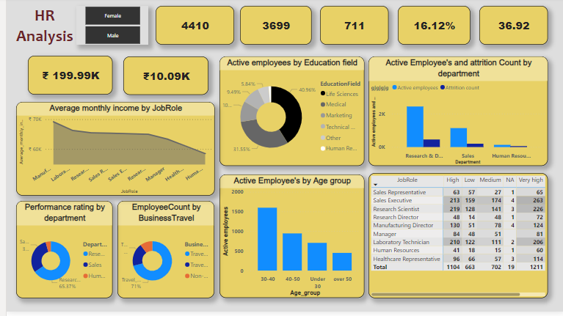
20. Develop a dashboard that provides an overview of key HR metrics, including headcount, performance, and training costs, using charts and pivot tables.

Slide 12
Thank you

